Slide 1

Kafka Connect
Dima Ionut Daniel

Slide 2
Contents
What are Kafka Connect ?
Concepts
Architecture
Core
Landoop
REST API
Bibliography

Slide 3

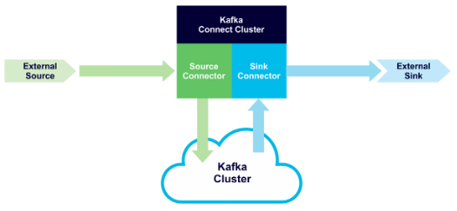
What are Kafka Connect ?
Kafka Connect is a tool for scalability and reliably streaming between Kafka and other data systems.
It makes it simple to quickly define connectors that move large data sets into and out of Kafka.
It can ingest entire databases or collect metrics from all your application servers into Kafka topics, making the data available for stream processing with low latency.
Kafka Connect is a free, open-source component of Apache Kafka that works as a centralized data hub for simple data integration between databases, key-value stores, search indexes, and file systems.

Slide 4
Concepts
Connectors: the high level abstraction that coordinates data streaming by managing tasks
Tasks: the implementation of how data is copied to or from Kafka
Workers: the running processes that execute connectors and tasks
Converters: the code used to translate data between Connect and the system sending or receiving data
Transforms: simple logic to alter each message produced by or sent to a connector
Dead Letter Queue: how Connect handles connector errors

Slide 5
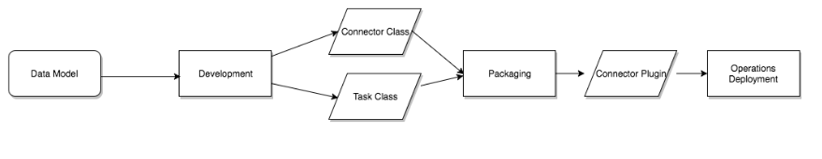
Concepts (cont.)
Connectors in Kafka Connect define where data should be copied to and from.
A connector instance is a logical job that is responsible for managing the copying of data between Kafka and another system.

Slide 6
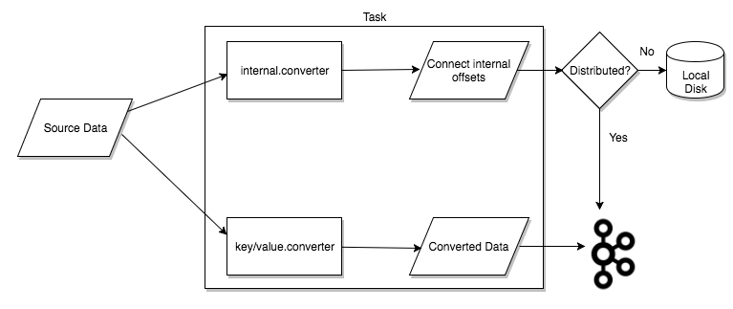
Concepts (cont.)
Tasks are the main actor in the data model for Connect.
Each connector instance coordinates a set of tasks that actually copy the data.
By allowing the connector to break a single job into many tasks, Kafka Connect provides built-in support for parallelism and scalable data copying with very little configuration.

Slide 7
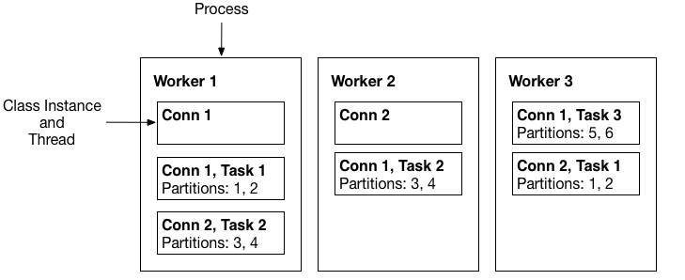
Concepts (cont.)
Connectors and tasks are logical units of work and must be scheduled to execute in a process.
Kafka Connect calls these processes workers and has two types of workers: standalone and distributed.
Standalone mode is the simplest mode, where a single process is responsible for executing all connectors and tasks.
Distributed mode provides scalability and automatic fault tolerance for Kafka Connect.

Slide 8
Concepts (cont.)
Converters are necessary to have a Kafka Connect deployment support a particular data format when writing to or reading from Kafka.
Tasks use converters to change the format of data from bytes to a Connect internal data format and vice versa.
By default, Confluent Platform provides the following converters:
AvroConverter io.confluent.connect.avro.AvroConverter: use with Schema Registry
ProtobufConverter io.confluent.connect.protobuf.ProtobufConverter: use with Schema Registry
JsonSchemaConverter io.confluent.connect.json.JsonSchemaConverter: use with Schema Registry
JsonConverter org.apache.kafka.connect.json.JsonConverter (without Schema Registry): use with structured data
StringConverter org.apache.kafka.connect.storage.StringConverter: simple string format
ByteArrayConverter org.apache.kafka.connect.converters.ByteArrayConverter: provides a “pass-through” option that does no conversion

Slide 9
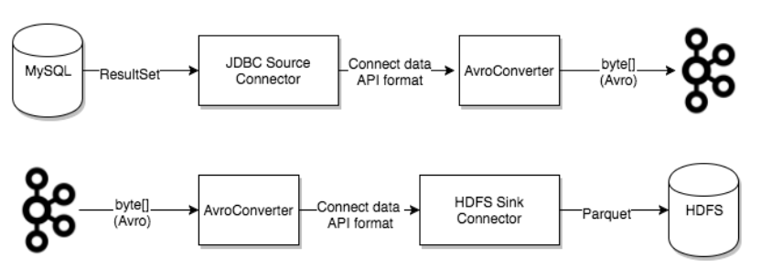
Concepts (cont.)
Converters are decoupled from connectors themselves to allow for reuse of converters between connectors naturally.

Slide 10
Concepts (cont.)
Connectors can be configured with transformations to make simple and lightweight modifications to individual messages.
A transform is a simple function that accepts one record as an input and outputs a modified record.
When transforms are used with a source connector, Kafka Connect passes each source record produced by the connector through the first transformation, which makes its modifications and outputs a new source record.

Slide 11
Concepts (cont.)
An invalid record may occur for a number of reasons.
An example is when a record arrives at the sink connector serialized in JSON format, but the sink connector configuration is expecting Avro format.
Dead letter queues are only applicable for sink connectors.

Slide 12
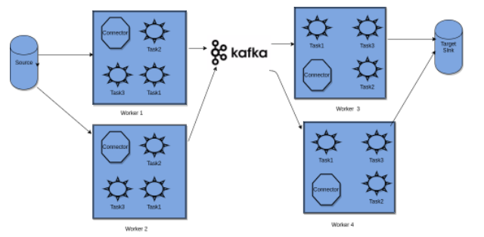
Architecture

Slide 13
Core
We can deploy Kafka Connect as a standalone process that runs jobs on a single machine (for example, log collection), or as a distributed, scalable, fault-tolerant service supporting an entire organization.
Kafka Connect provides a low barrier to entry and low operational overhead.

Slide 14
Core (cont.)
Kafka Connect includes two types of connectors:
Source connector
Ingests entire databases and streams table updates to Kafka topics.
A source connector can also collect metrics from all your application servers and store these in Kafka topics, making the data available for stream processing with low latency.
Sink connector
Delivers data from Kafka topics into secondary indexes such as Elasticsearch, or batch systems such as Hadoop for offline analysis.

Slide 15
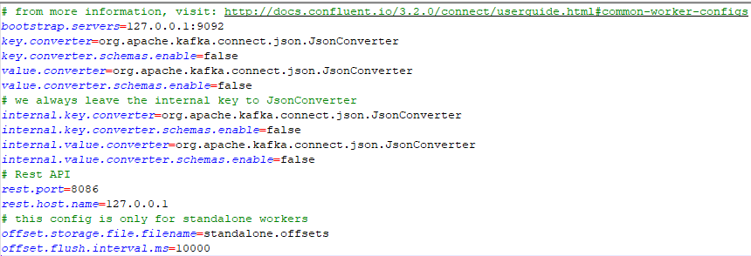
Core (cont.)
We can start a source standalone file connector using the command: connect-standalone worker.properties file-stream-demo-standalone.properties
The worker.properties contains worker properties
The file-stream-demo-standalone.properties contains container properties

Slide 16
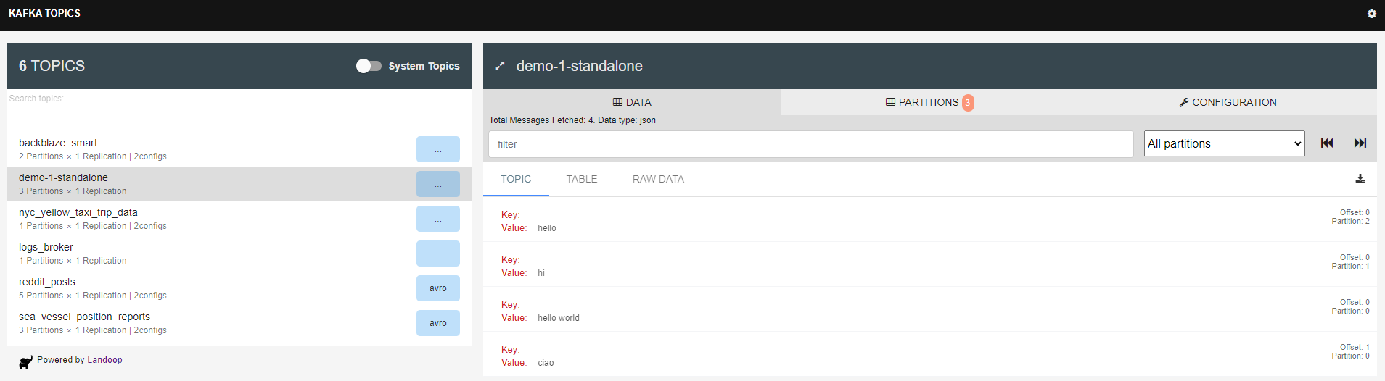
Core (cont.)
Before starting the connector, we create the topic “kafka-topics --create --topic demo-1-standalone --partitions 3 --replication-factor 1 --zookeeper 127.0.0.1:2181”. After the connector is started, we can write into the text file and check the topics for the data.

Slide 17
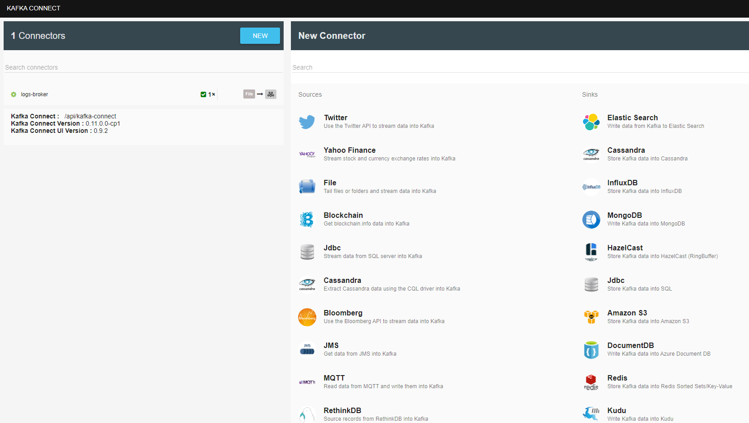
Core (cont.)
We can run connectors in distributed mode. In Landoop UI, go to the connector screen and click the “New” button. After we select the connector and we set the configuration we click the “Create” button.

Slide 18
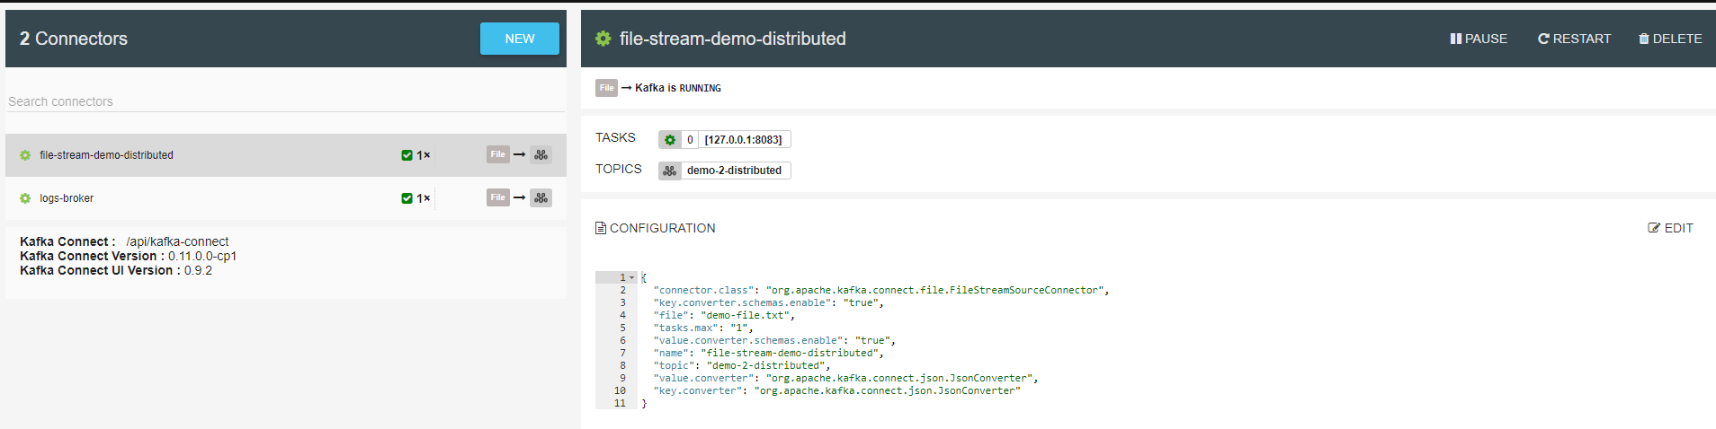
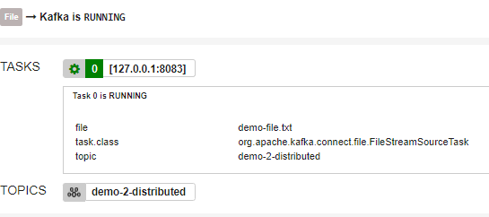
Core (cont.)
In distributed mode we don’t need worker configuration, we need only connector configuration file.
We can select a connector and query it’s status.
We can see the running tasks, topics and configuration

Slide 19
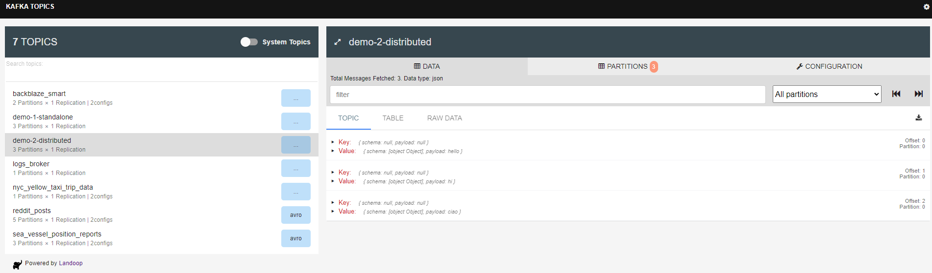
Core (cont.)
We can push data to the text file and check the Kafka topic for the new data.

Slide 20
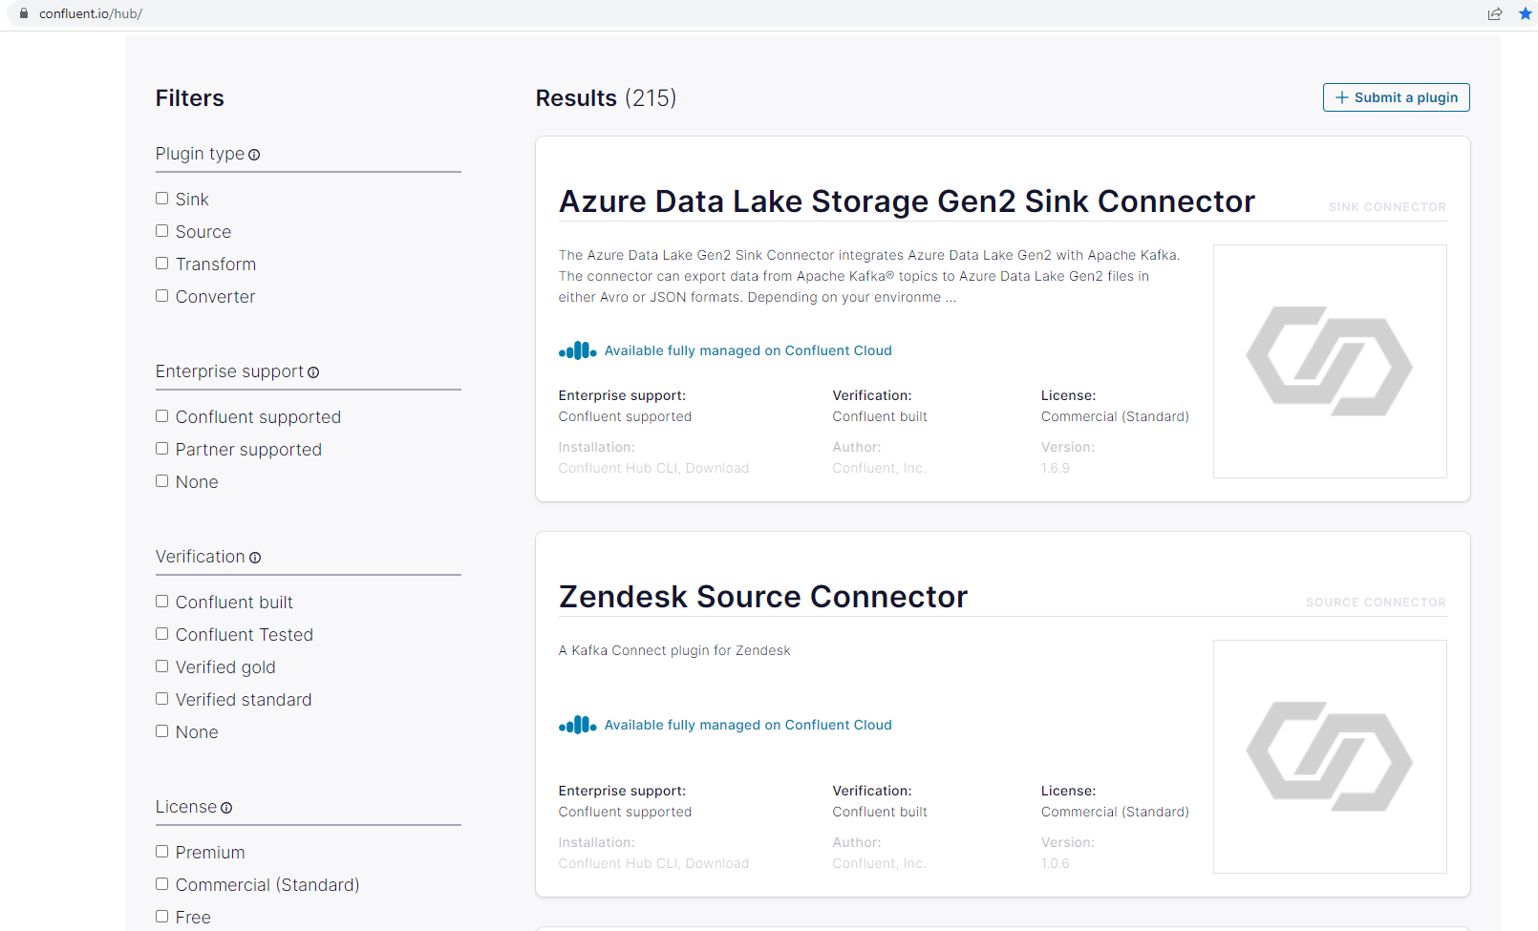
Core (cont.)
We can check for available connectors on https://www.confluent.io/hub/ website

Slide 21
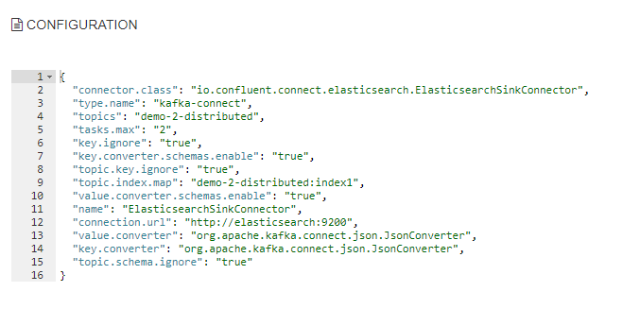
Core (cont.)
We can create sink connectors by going to Ladoop Connectors screen, click New button and select the SINK connector. After we configure it we can create it.

Slide 22
Landoop
Lenses.io, formerly Landoop, is a streaming data management platform for Apache Kafka.
Lenses supports the core elements of Kafka with a web UI and enterprise capabilities that enable engineering and data teams to query real-time data and to create and monitor Kafka topologies.

Slide 23
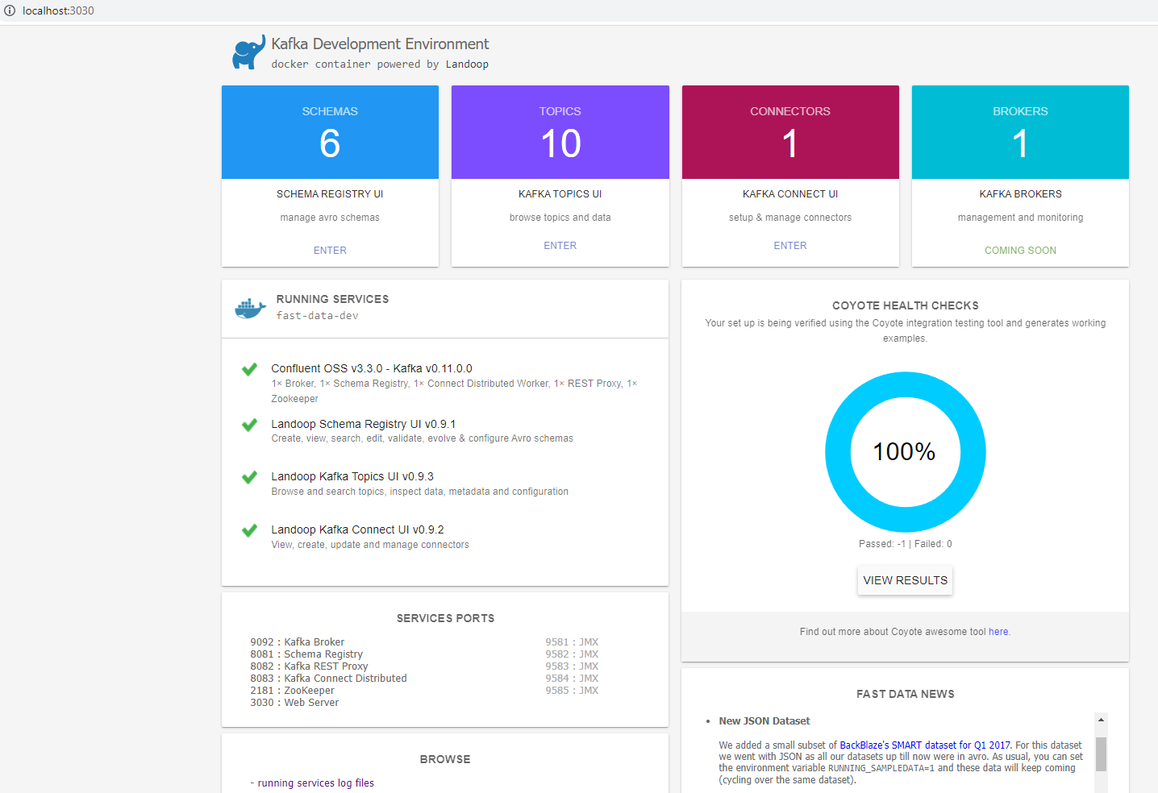
Landoop (cont.)

Slide 24
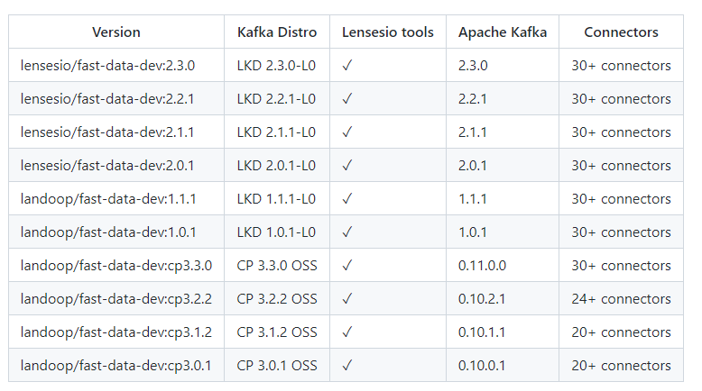
Landoop (cont.)
Using docker/docker-compose we can use the image landoop/fast-data-dev:cp3.3.0, that will bring up:
Zookeeper
Kafka Broker
Landoop UI
REST Proxy, Schema Registry, Kafka Connect ports
Other JMX ports

Slide 25
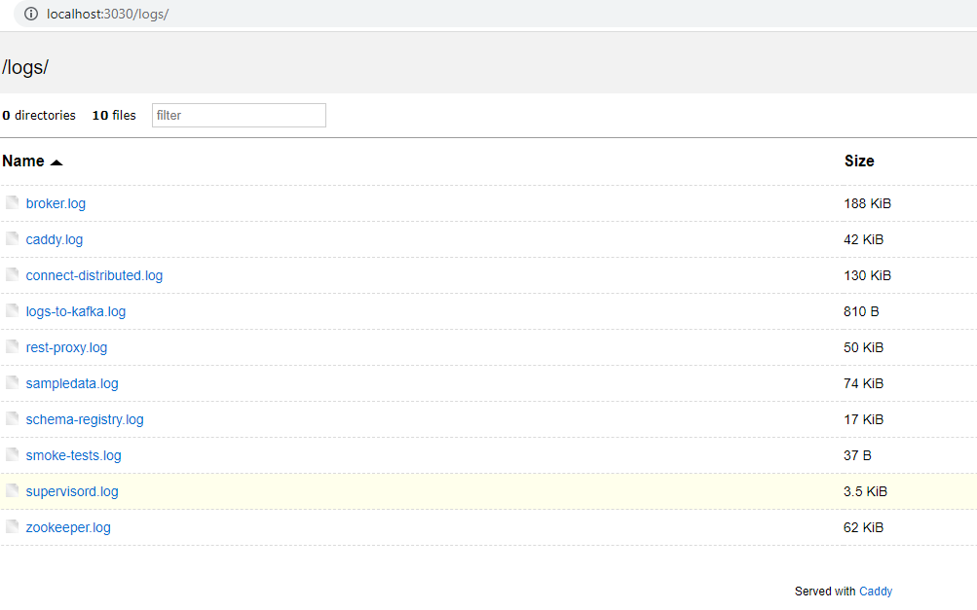
Landoop (cont.)
We can check the aggregated log by checking the url: http://localhost:3030/logs/

Slide 26

REST API
Kafka Connect is managed by a REST API
List connectors available on a Worker
curl -s 127.0.0.1:8083/connector-plugins | jq
Gets active connectors
curl -s 127.0.0.1:8083/connectors | jq

Slide 27
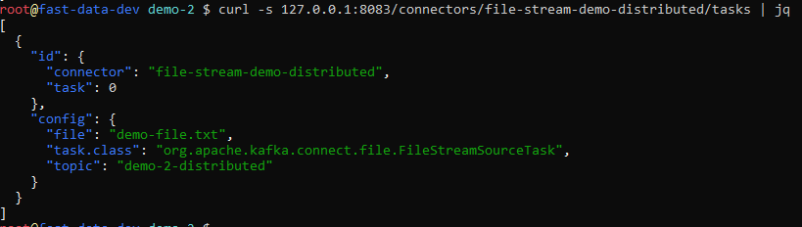
REST API
Gets information about a connector tasks and config
curl -s 127.0.0.1:8083/connectors/<CONNECTOR_NAME>/tasks | jq

Slide 28
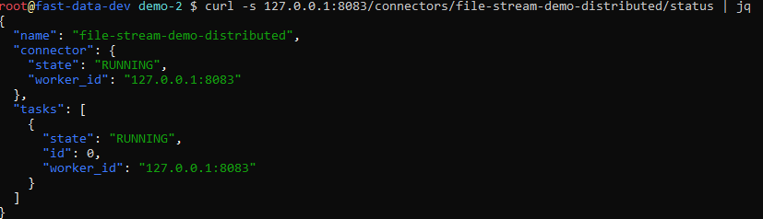
REST API (cont.)
Get connector status
curl -s 127.0.0.1:8083/connectors/<CONNECTOR_NAME>/status | jq

Slide 29
REST API (cont.)
Pause / Resume a Connector (no response if the call is successful)
curl -s -X PUT 127.0.0.1:8083/connectors/<CONNECTOR_NAME>/pause
curl -s -X PUT 127.0.0.1:8083/connectors/<CONNECTOR_NAME>/resume

Slide 30
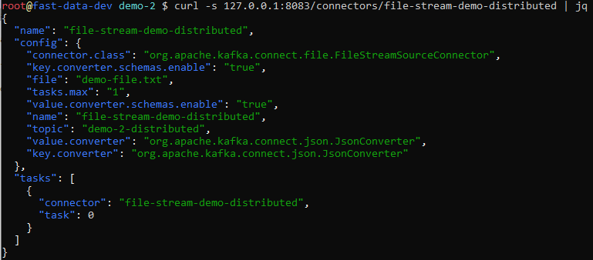
REST API (cont.)
Get Connector Configuration
curl -s 127.0.0.1:8083/connectors/<CONNECTOR_NAME> | jq

Slide 31
REST API (cont.)
Delete our Connector
curl -s -X DELETE 127.0.0.1:8083/connectors/<CONNECTOR_NAME>
Create a new Connector
curl -s -X POST -H "Content-Type: application/json" --data '{"name": "file-stream-demo-distributed", "config":{"connector.class":"org.apache.kafka.connect.file.FileStreamSourceConnector","key.converter.schemas.enable":"true","file":"demo-file.txt","tasks.max":"1","value.converter.schemas.enable":"true","name":"file-stream-demo-distributed","topic":"demo-2-distributed","value.converter":"org.apache.kafka.connect.json.JsonConverter","key.converter":"org.apache.kafka.connect.json.JsonConverter"}}' http://127.0.0.1:8083/connectors | jq

Slide 32
REST API (cont.)
Update Connector configuration
curl -s -X PUT -H "Content-Type: application/json" --data '{"connector.class":"org.apache.kafka.connect.file.FileStreamSourceConnector","key.converter.schemas.enable":"true","file":"demo-file.txt","tasks.max":"2","value.converter.schemas.enable":"true","name":"file-stream-demo-distributed","topic":"demo-2-distributed","value.converter":"org.apache.kafka.connect.json.JsonConverter","key.converter":"org.apache.kafka.connect.json.JsonConverter"}' 127.0.0.1:8083/connectors/file-stream-demo-distributed/config | jq

Slide 33
Conclussion
Do not reinvent the wheel

Slide 34

Bibliography
https://docs.confluent.io/platform/current/connect/index.html
https://hub.docker.com/r/landoop/fast-data-dev
Udemy – Kafka Connect

Slide 35
Questions ?

